Slide 1

MITRE CNP Presentation
Presented by:
Devin Young

Slide 2






About Me
Senior Computer Technology Major
(Concentration in Network Enterprise Infrastructure)
Information Security Analyst Intern
Upcoming IT Support Intern
Cyber Futures Intern
Cybersecurity Intern
(NASA CyPrESS)

Slide 3
Summary of Internships
MITRE – Developed a cyber defense mindset while conducting research on various mitigations and detections that I eventually proposed to be added under specific techniques within the MITRE ATT&CK Framework
Booz Allen Hamilton (NASA CyPrESS) – Exposed to a SOC environment where I gained experience with incident response tools and the development of standard operating procedures for asset compromise (Splunk, SentinelOne, etc.)
Federated Hermes – Gained hands-on experience with hunting for threats in Microsoft Outlook emails that employees found suspicious and reported using the phish alert button (Microsoft Defender, Mimecast, VirusTotal, Crowdstrike Falcon, etc.)

Slide 4
Objective
Apply what I've learned throughout academic coursework and internships to propose a series of mitigations that could have been implemented to prevent the research collaboration network at MITRE known as NERVE from being infiltrated by a Chinese nation-state adversary

Slide 5
Initial Access
RootRot webshell was deployed on an "on an external-facing Ivanti appliance, gaining initial access to NERVE, a MITRE prototyping network" (Crumpton, 2024)
This involved the exploitation of two zero-day vulnerabilities within Ivanti Connect Secure (Secure Sockets Layer VPN)
CVE-2023-46805: An authentication bypass vulnerability in the web component of Ivanti Connect Secure and Ivanti Policy Secure that allowed a remote attacker to bypass control checks and access restricted resources (CVE - CVE-2023-46805, n.d.)
CVE-2024-21887: A command injection vulnerability in web components of Ivanti Connect Secure and Ivanti Policy Secure that allowed the adversary to execute arbitrary commands on the appliance (CVE - CVE-2024-21887, n.d.)
Notes:
A web shell is a malicious script that allows an attacker to remotely access a web server and perform a variety of harmful actions

Slide 6
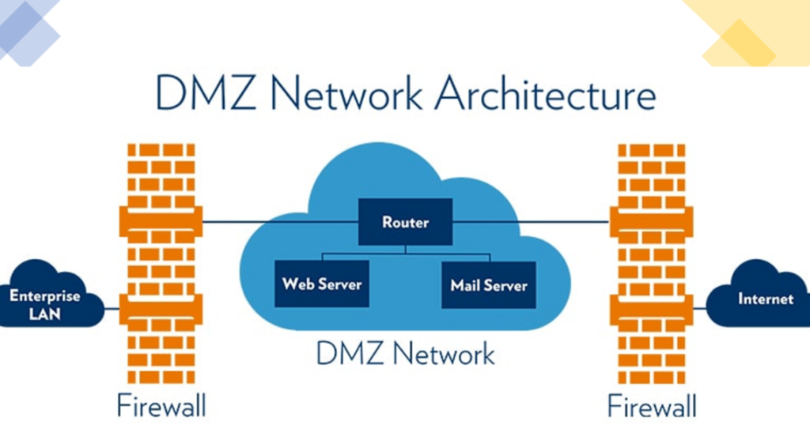
Phase 1 of mitigation proposal – DMZ
Implement a DMZ and configure the VPN to route authenticated users (employees) to the internal network, but direct unauthenticated or suspicious users (attackers exploiting authentication bypass) to the DMZ
Use stateful packet inspection firewalls and ACLs to prevent direct communication between the DMZ and the internal network
(Haff, 2022)
Notes:
This way, even if an attacker gains access to the DMZ, they cannot easily pivot into the internal network

Slide 7
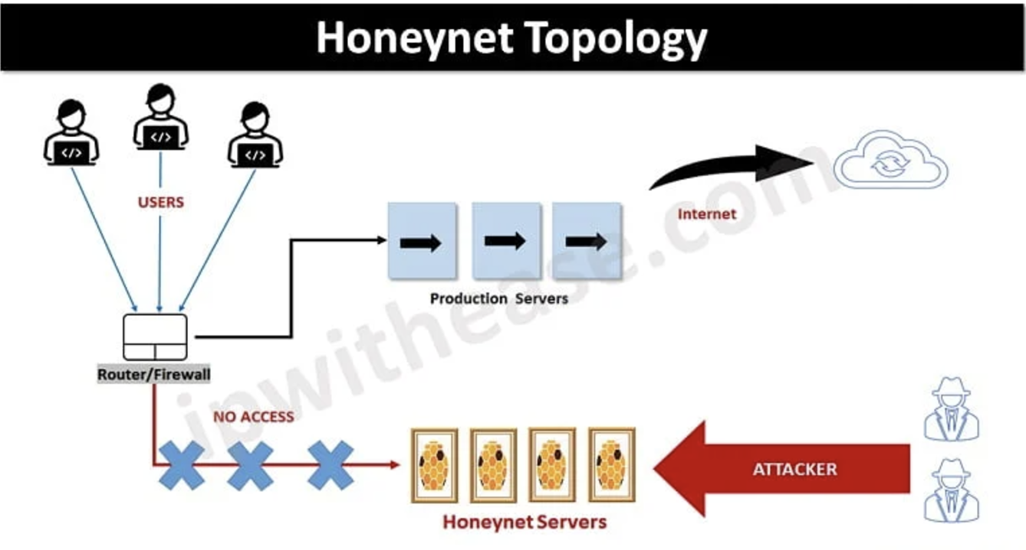
Phase 2 of mitigation proposal – Deploy Honeynet within the dmz
Deploy decoy servers and services that simulate vulnerable MITRE internal infrastructure, such as fake web applications, databases, or file shares
Set up fake login pages to lure attackers who have bypassed authentication. When attackers try to authenticate to these fake pages, you can capture their credentials, IP address, and tools used
(Bhardwaj, 2022)
Notes:
Use IDS and HIDS to monitor failed login attempts, unauthorized access attempts, or suspicious authentication bypass methods, as well as set up signature-based or anomaly detection to identify suspicious input patterns indicating command injection attempts
Use one-way network bridges to ensure that data can only flow into the DMZ but not out
As an extra layer of protection, use deep packet inspection on outbound traffic from the DMZ, including traffic from the honeypot, to detect and block any attempts by attackers to exfiltrate data or send malicious commands to external or internal systems

Slide 8

Phase 3 of mitigation proposal – Redirection to virtual sandbox
Implement honeytoken files and fake admin credentials within the honeynet that direct the adversary to a virtual sandbox outside of the internal network
Simulate a Command-and-Control (C2) server that sends the attacker to separate decoy systems that then connects to a virtual sandbox outside of the internal network
DNS/HTTPS Redirection
(Hassan, 2023)
Notes:
If the attacker attempts to connect to certain services or requests specific data, you could redirect their traffic using DNS poisoning or HTTP redirects, effectively sending them to a virtual sandbox outside of the internal network
Place the virtualized sandbox on a VLAN with no routing to the internal network
Disconnect the sandbox from the internet and restrict outbound communication
Ensure that the filesystem within the sandbox is completely isolated from your actual internal network's file systems
Set the sandbox environment to be temporary and disposable
Ensure that the sandbox environment is periodically reset to a clean state after each engagement.

Slide 9
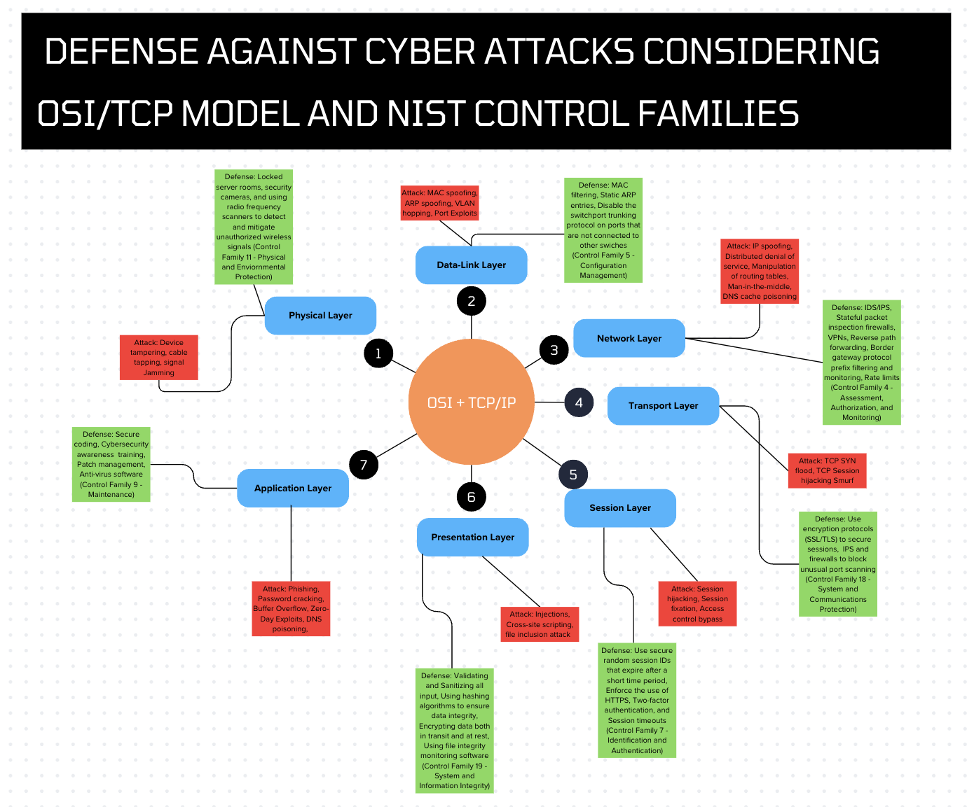
Best Practices for all networks

Slide 10
Overall Recommendation
Understanding that:
SSL VPNs are highly targeted because the exploitation of their vulnerabilities can lead to gaining access to an internal network
MITRE has no control over Ivanti's response time to vulnerabilities within its software
MITRE should consider reevaluating its network security architecture, even for a prototype networking environment:
Detection and mitigation tools to threat hunt within the internal network and other network security efforts within the internal network is great
Layers of strategies to prevent initial access into the internal network is even better

Slide 11
Significance of Presentation
Based on the research I conducted; general best practices and detailed incident response efforts were mentioned but a strategy that could have mitigated the intrusion was not
Combines my academic background in network enterprise infrastructure and internship experience in information security
Displays how I can currently be an asset, hence my unique train of thought and analytical skills

Slide 12
References
Bhardwaj, R. (2022, July 13). Honeypot vs Honeynet: Complete Guide - IP With Ease. IP With Ease. https://ipwithease.com/honeypot-vs-honeynet-complete-guide/
Crumpton, L. (2024c, November 28). Advanced cyber threats impact even the most prepared. Medium. https://medium.com/mitre-engenuity/advanced-cyber-threats-impact-even-the-most-prepared-56444e980dc8
Crumpton, L. (2024a, November 25). Infiltrating Defenses: Abusing VMware in MITRE’s cyber intrusion. Medium. https://medium.com/mitre-engenuity/infiltrating-defenses-abusing-vmware-in-mitres-cyber-intrusion-4ea647b83f5b
Crumpton, L. (2024, November 27). Technical Deep Dive: Understanding the Anatomy of a Cyber Intrusion | Center for Threat-Informed Defense. Medium. https://medium.com/mitre-engenuity/technical-deep-dive-understanding-the-anatomy-of-a-cyber-intrusion-080bddc679f3

Slide 13
References
CVE - CVE-2023-46805. (n.d.). https://cve.mitre.org/cgi-bin/cvename.cgi?name=CVE-2023-46805
CVE - CVE-2024-21887. (n.d.). https://cve.mitre.org/cgi-bin/cvename.cgi?name=CVE-2024-21887
Haff, E. (2022, February 2). What is an IDMZ? https://pages.rexelusa.com/blog/automation/idmz
Hassan, A. (2023, March 28). What is a sandbox environment? Built In. https://builtin.com/software-engineering-perspectives/sandbox-environment

